Slide 1



COMPUTER GRAPHICS & MULTIMEDIA SYSTEMS SCS1302
UNIT III – PART II

Slide 2
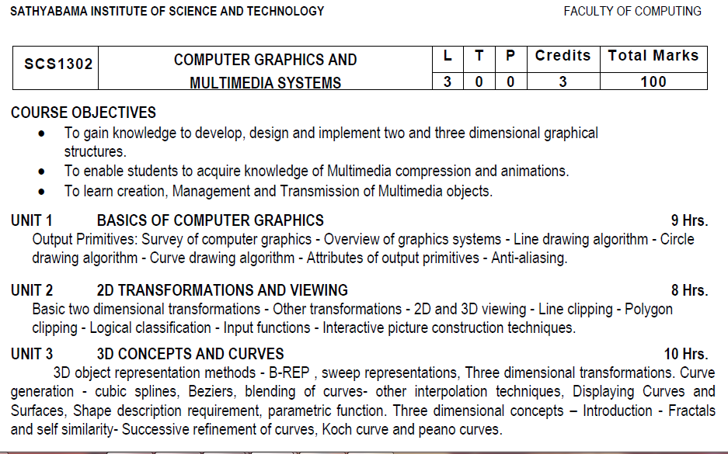
Syllabus

Slide 3
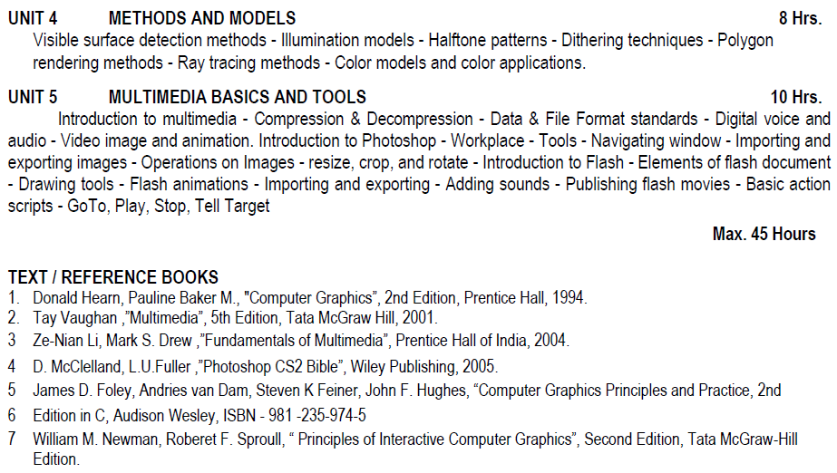
Syllabus

Slide 4
Course Objective(CO)
CO1: Construct lines and circles for the given input.
CO2: Apply 2D transformation techniques to transform the shapes to fit them as per the picture definition.
CO3: Construct splines, curves and perform 3D transformations
CO4: Apply colour and transformation techniques for various applications.
CO5: Analyse the fundamentals of animation, virtual reality, and underlying technologies.
CO6: Develop photo shop applications

Slide 5
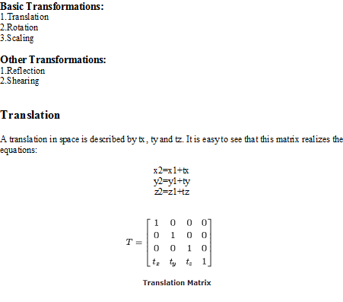
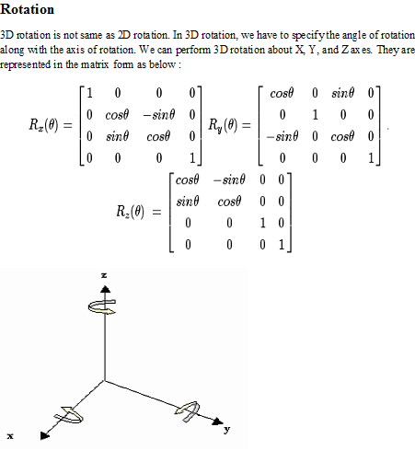
Three dimensional transformations

Slide 6
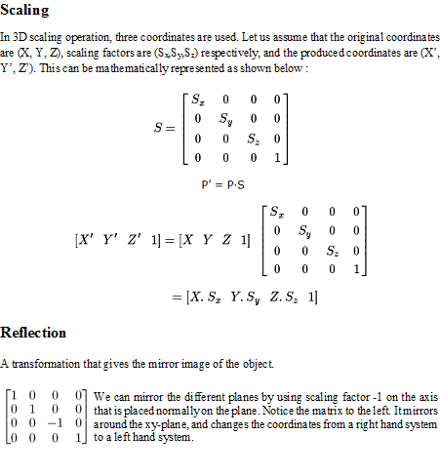
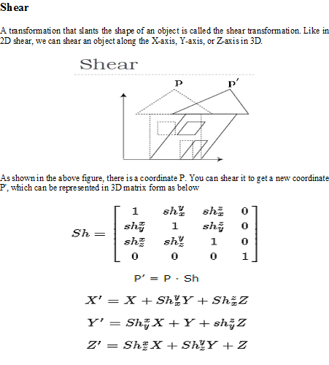
Three dimensional transformations

Slide 7
Translation - Example
Given a 3D object with coordinate points A(0, 3, 1), B(3, 3, 2), C(3, 0, 0), D(0, 0, 0). Apply the translation with the distance 1 towards X axis, 1 towards Y axis and 2 towards Z axis and obtain the new coordinates of the object.
Given-
Old coordinates of the object = A (0, 3, 1), B(3, 3, 2), C(3, 0, 0), D(0, 0, 0)
Translation vector = (T_{x}, T_{y}, T_{z}) = (1, 1, 2)
For Coordinates A(0, 3, 1)
Let the new coordinates of A = (X’, Y’, Z’).
Applying the translation equations, we have-
X’ = X + T_{x} = 0 + 1 = 1
Y’ = Y + T_{y} = 3 + 1 = 4
Z’ = Z + T_{z} = 1 + 2 = 3
Thus, New coordinates of A = (1, 4, 3).

Slide 8
Translation - Example
For Coordinates B(3, 3, 2)
Let the new coordinates of B = (X’, Y’, Z’).
Applying the translation equations, we have-
X’ = X + T_{x} = 3 + 1 = 4
Y’ = Y + T_{y} = 3 + 1 = 4
Z’ = Z + T_{z} = 2 + 2 = 4
Thus, New coordinates of B = (4, 4, 4).
For Coordinates C(3, 0, 0)
Let the new coordinates of C = ((X’, Y’, Z’).
Applying the translation equations, we have-
X’ = X + T_{x} = 3 + 1 = 4
Y’ = Y + T_{y} = 0 + 1 = 1
Z’ = Z + T_{z} = 0 + 2 = 2
Thus, New coordinates of C = (4, 1, 2).

Slide 9
Translation - Example
For Coordinates D(0, 0, 0)
Let the new coordinates of D = (X’, Y’, Z’).
Applying the translation equations, we have-
X’ = X + T_{x} = 0 + 1 = 1
Y’ = Y + T_{y} = 0 + 1 = 1
Z’ = Z + T_{z} = 0 + 2 = 2
Thus, New coordinates of D = (1, 1, 2).
Thus, New coordinates of the object = A (1, 4, 3), B(4, 4, 4), C(4, 1, 2), D(1, 1, 2).

Slide 10
Rotation - Example
Given a homogeneous point (1, 2, 3). Apply rotation 90 degree towards X, Y and Z axis and find out the new coordinate points.
Solution-
Given-
Old coordinates = (X, Y, Z) = (1, 2, 3)
Rotation angle = θ = 90º

Slide 11
For X-Axis Rotation-
This rotation is achieved by using the following rotation equations-
X’ = X
Y’ = Y cosθ – Z sinθ
Z’ = Y sinθ + Z cosθ
For Y-Axis Rotation-
This rotation is achieved by using the following rotation equations-
X’ = Z sinθ + X cosθ
Y’ = Y
Z’ = Y cosθ – X sinθ
For Z-Axis Rotation-
This rotation is achieved by using the following rotation equations-
X’ = X cosθ – Y sinθ
Y’ = X sinθ + Y cosθ
Z’ = Z

Slide 12
Rotation - Example
For X-Axis Rotation-
Let the new coordinates after rotation = (X’, Y’, Z’).
Applying the rotation equations, we have-
X’ = X = 1
Y’ = Y cosθ – Z sinθ
= 2 cos90° – 3 sin90°
= 2 x 0 – 3 x 1 = -3
Z’ = Y sinθ + Z cosθ
= 2 sin90° + 3 cos90°
= 2 x 1 + 3 x 0 = 2
Thus, New coordinates after rotation = (1, -3, 2).
For Y-Axis Rotation-
Let the new coordinates after rotation = (X’, Y’, Z’).
Applying the rotation equations, we have-
X’ = Z sinθ + X cosθ
= 3 sin90° + 1 cos90°
= 3 x 1 + 1 x 0 = 3
Y’ = Y = 2
Z’ = Y cosθ – X sinθ
= 2 x cos90° – 1 x sin90°
= 2 x 0 – 1 x 1 = -1
Thus, New coordinates after rotation = (3, 2, -1).

Slide 13
Rotation - Example
For Z-Axis Rotation-
Let the new coordinates after rotation = (X’, Y’, Z’).
Applying the rotation equations, we have-
X’ = X cosθ – Y sinθ
= 1 x cos90° – 2 x sin90°
= 1 x 0 – 2 x 1 = -2
Y’= X sinθ + Y cosθ
= 1 x sin90° + 2 x cos90°
= 1 x 1 + 2 x 0 = 1
Z’= Z= 3
Thus, New coordinates after rotation = (-2, 1, 3).

Slide 14
Scaling
Consider a point object O has to be scaled in a 3D plane.
Let-
Initial coordinates of the object O = (X, Y,Z)
Scaling factor for X-axis = S_{x}
Scaling factor for Y-axis = S_{y}
Scaling factor for Z-axis = S_{z}
New coordinates of the object O after scaling = (X’, Y’, Z’)
This scaling is achieved by using the following scaling equations-
X’ = X x S_{x}
Y’ = Y x S_{y}
Z’ = Z x S_{z}

Slide 15
Scaling - Example
Given a 3D object with coordinate points A(0, 3, 3), B(3, 3, 6), C(3, 0, 1), D(0, 0, 0). Apply the scaling parameter 2 towards X axis, 3 towards Y axis and 3 towards Z axis and obtain the new coordinates of the object.
Solution-
Given-
Old coordinates of the object = A (0, 3, 3), B(3, 3, 6), C(3, 0, 1), D(0, 0, 0)
Scaling factor along X axis = 2
Scaling factor along Y axis = 3
Scaling factor along Z axis = 3

Slide 16
Scaling - Example
For Coordinates A(0, 3, 3)
Let the new coordinates of A after scaling = (X’, Y’, Z’).
Applying the scaling equations, we have-
X’ = X x S_{x} = 0 x 2 = 0
Y’ = Y x S_{y} = 3 x 3 = 9
Z’ = Z x S_{z} = 3 x 3 = 9
Thus, New coordinates of corner A after scaling = (0, 9, 9).
For Coordinates B(3, 3, 6)
Let the new coordinates of B after scaling = (X’, Y’, Z’).
Applying the scaling equations, we have-
X’ = X x S_{x} = 3 x 2 = 6
Y’ = Y x S_{y} = 3 x 3 = 9
Z’ = Z x S_{z} = 6 x 3 = 18
Thus, New coordinates of corner B after scaling = (6, 9, 18).

Slide 17
Scaling - Example
For Coordinates C(3, 0, 1)
Let the new coordinates of C after scaling = (X’, Y’, Z’).
Applying the scaling equations, we have-
X’ = X x S_{x} = 3 x 2 = 6
Y’ = Y x S_{y} = 0 x 3 = 0
Z’ = Z x S_{z} = 1 x 3 = 3
Thus, New coordinates of corner C after scaling = (6, 0, 3).
For Coordinates D(0, 0, 0)
Let the new coordinates of D after scaling = (X’, Y’, Z’).
Applying the scaling equations, we have-
X’ = X x S_{x} = 0 x 2 = 0
Y’ = Y x S_{y} = 0 x 3 = 0
Z’ = Z x S_{z} = 0 x 3 = 0
Thus, New coordinates of corner D after scaling = (0, 0, 0).

Slide 18
Reflection - Example
Reflection relative to XY plane
Reflection relative to YZ plane
Reflection relative to XZ plane
Reflection Relative to XY Plane:
This reflection is achieved by using the following reflection equations-
X’ = X
Y’ = Y
Z’ = -Z
Reflection Relative to YZ Plane:
This reflection is achieved by using the following reflection equations-
X’ = -X
Y’ = Y
Z’ = Z
Reflection Relative to XZ Plane:
This reflection is achieved by using the following reflection equations-
X’ = X
Y’ = -Y
Z’ = Z

Slide 19
Reflection - Example
Given a 3D triangle with coordinate points A(3, 4, 1), B(6, 4, 2), C(5, 6, 3). Apply the reflection on the XY plane and find out the new coordinates of the object.
Solution
Given:
Coordinates of the triangle = A (3, 4, 1), B(6, 4, 2), C(5, 6, 3)
Reflection has to be taken on the XY plane
For Coordinates A(3, 4, 1)
Let the new coordinates of corner A after reflection = (X’, Y’, Z’).
Applying the reflection equations, we have-
X’ = X = 3
Y’ = Y = 4
Z’ = -Z = -1
Thus, New coordinates of corner A after reflection = (3, 4, -1).

Slide 20
Reflection - Example
For Coordinates B(6, 4, 2)
Let the new coordinates of corner B after reflection = (X’, Y’, Z’).
Applying the reflection equations, we have-
X’ = X = 6
Y’ = Y = 4
Z’ = -Z = -2
Thus, New coordinates of corner B after reflection = (6, 4, -2).
For Coordinates C(5, 6, 3)
Let the new coordinates of corner C after reflection = (X’, Y’, Z’).
Applying the reflection equations, we have-
X’ = X = 5
Y’ = Y = 6
Z’ = -Z = -3
Thus, New coordinates of corner C after reflection = (5, 6, -3).
Thus, New coordinates of the triangle after reflection = A (3, 4, -1), B(6, 4, -2), C(5, 6, -3).

Slide 21
Shearing - Example
Shearing parameter towards X direction = Sh_{x}
Shearing parameter towards Y direction = Sh_{y}
Shearing parameter towards Z direction = Sh_{z}
Shearing in X Axis-
Shearing in X axis is achieved by using the following shearing equations-
X’ = X
Y’ = Y + Sh_{y} x X
Z’ = Z + Sh_{z} x X
Shearing in Y Axis-
Shearing in Y axis is achieved by using the following shearing equations-
X’ = X + Sh_{x} x Y
Y’ = Y
Z’ = Z + Sh_{z} x Y
Shearing in Z Axis-
Shearing in Z axis is achieved by using the following shearing equations-
X’ = X + Sh_{x} x Z
Y’ = Y + Sh_{y} x Z
Z’ = Z

Slide 22
Shearing - Example
Given a 3D triangle with points (0, 0, 0), (1, 1, 2) and (1, 1, 3). Apply shear parameter 2 on X axis, 2 on Y axis and 3 on Z axis and find out the new coordinates of the object.
Solution-
Given-
Old corner coordinates of the triangle = A (0, 0, 0), B(1, 1, 2), C(1, 1, 3)
Sh_{x} = 2
Sh_{y} = 2
Sh_{z} = 3
Shearing in X Axis-
For Coordinates A(0, 0, 0)
Let the new coordinates of corner A after shearing = (X’, Y’, Z’).
Applying the shearing equations, we have-
X’ = X = 0
Y’ = Y + Sh_{y} x X = 0 + 2 x 0 = 0
Z = Z + Sh_{z} x X = 0 + 3 x 0 = 0
Thus, New coordinates of corner A after shearing = (0, 0, 0).

Slide 23
Shearing - Example
For Coordinates B(1, 1, 2)
Let the new coordinates of corner B after shearing = (X’, Y’, Z’).
Applying the shearing equations, we have-
X’ = X = 1
Y’ = Y + Sh_{y} x X = 1 + 2 x 1 = 3
Z’ = Z + Sh_{z} x X = 2 + 3 x 1 = 5
Thus, New coordinates of corner B after shearing = (1, 3, 5).
For Coordinates C(1, 1, 3)
Let the new coordinates of corner C after shearing = (X’, Y’, Z’).
Applying the shearing equations, we have-
X’ = X = 1
Y’ = Y + Sh_{y} x X = 1 + 2 x 1 = 3
Z’ = Z + Sh_{z} x X = 3 + 3 x 1 = 6
Thus, New coordinates of corner C after shearing = (1, 3, 6).
Thus, New coordinates of the triangle after shearing in X axis = A (0, 0, 0), B(1, 3, 5), C(1, 3, 6).

Slide 24
Curve generation – Beziers Curves– B Spline Curves

Slide 25
Types of Curves
A curve is an infinitely large set of points. Each point has two neighbors except endpoints. Curves can be broadly classified into three categories − explicit, implicit, and parametric curves.
Implicit Curves
Implicit curve representations define the set of points on a curve by employing a procedure that can test to see if a point in on the curve. Usually, an implicit curve is defined by an implicit function of the form −
f(x, y) = 0
It can represent multivalued curves (multiple y values for an x value). A common example is the circle, whose implicit representation is
x² + y² - R² = 0

Slide 26
Types of Curves
2. Explicit Curves
A mathematical function y = f(x) can be plotted as a curve. Such a function is the explicit representation of the curve. The explicit representation is not general, since it cannot represent vertical lines and is also single-valued. For each value of x, only a single value of y is normally computed by the function.
3. Parametric Curves
Curves having parametric form are called parametric curves. The explicit and implicit curve representations can be used only when the function is known. In practice the parametric curves are used. A two-dimensional parametric curve has the following form −
P(t) = f(t), g(t) or P(t) = x(t), y(t)
The functions f and g become the (x, y) coordinates of any point on the curve, and the points are obtained when the parameter t is varied over a certain interval [a, b], normally [0, 1].

Slide 27
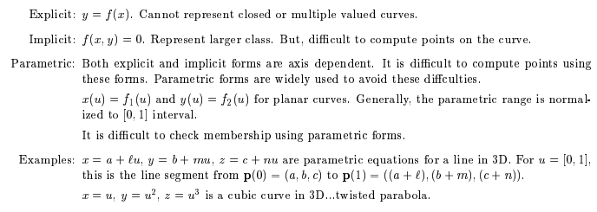
Types of Curves

Slide 28
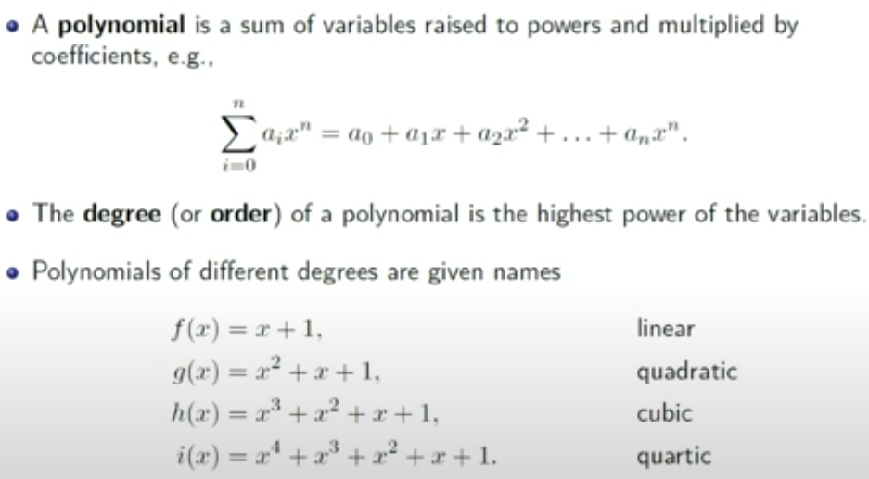
BEZIER CURVES

Slide 29
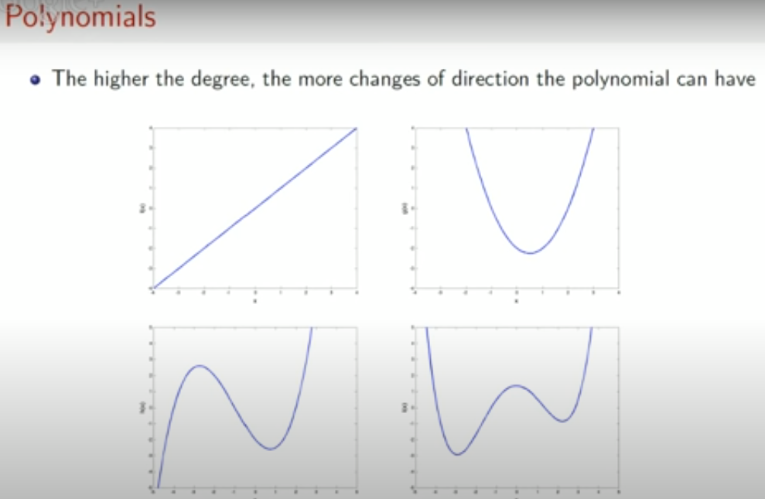
BEZIER CURVES

Slide 30
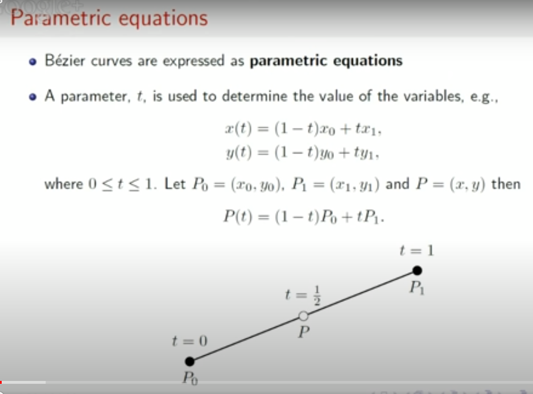

Slide 31
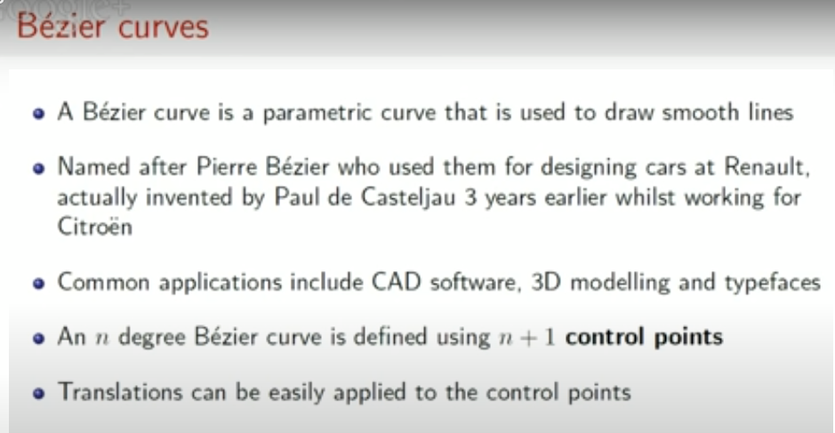

Slide 32
Bezier Curve
The concept of bezier curves was given by Pierre Bezier.
Bezier Curve may be defined as-
Bezier are ends of the curve.
Other Curve is parametric curve defined by a set of control points.
Two points points determine the shape of the curve.

Slide 33
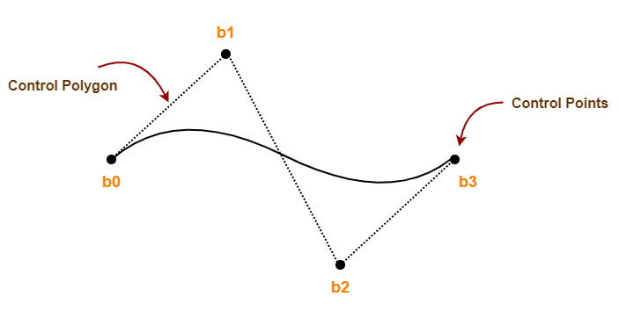
Example of a Bezier Curve
Here,
This bezier curve is defined by a set of control points b₀, b₁, b₂ and b₃.
Points b₀ and b₃ are ends of the curve.
Points b₁ and b₂ determine the shape of the curve.

Slide 34
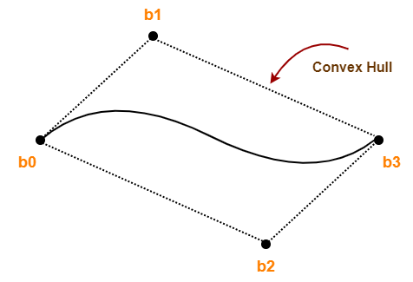
Bezier Curve Properties
Bezier curve is always contained within a polygon called as convex hull of its control points.
Bezier curve generally follows the shape of its defining polygon.
The first and last points of the curve are coincident with the first and last points of the defining polygon.
The degree of the polynomial defining the curve segment is one less than the total number of control points.
Degree = Num of Control Points – 1

Slide 35
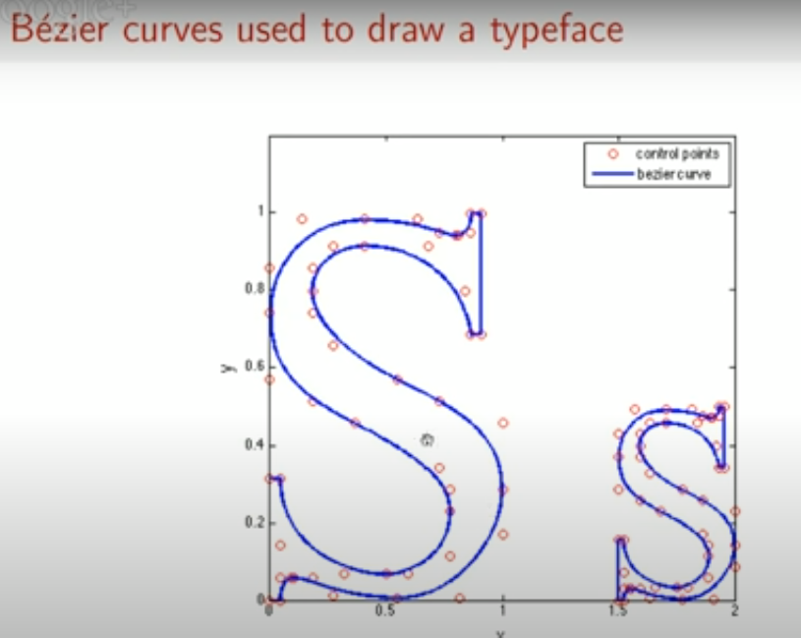

Slide 36
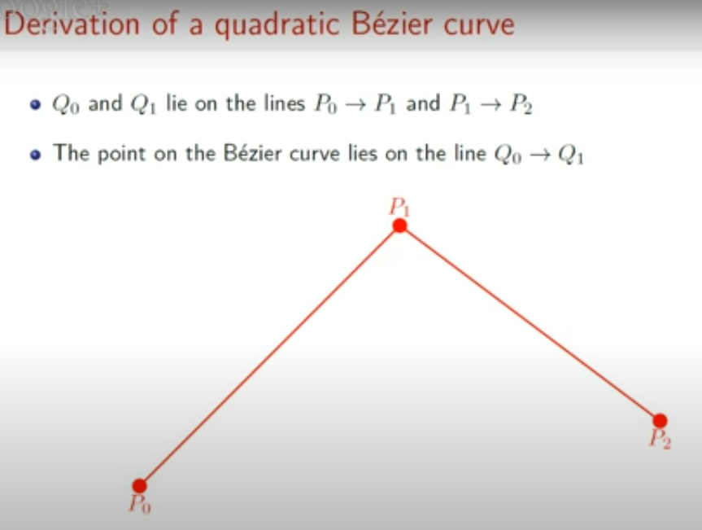

Slide 37
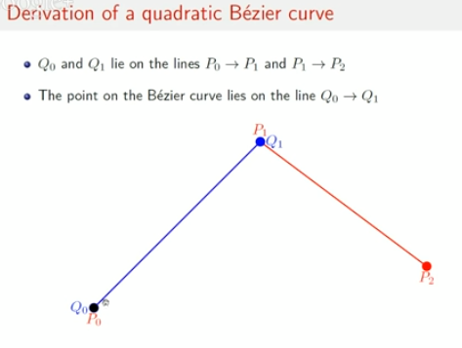
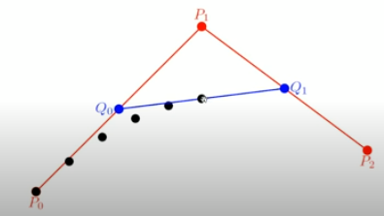
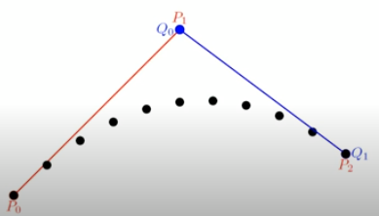
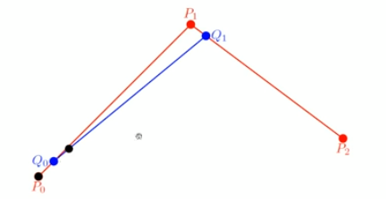

Slide 38
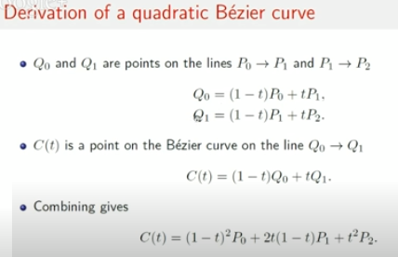
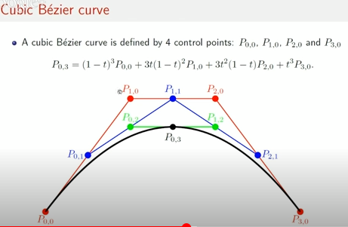

Slide 39
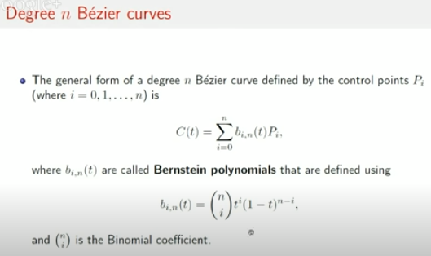
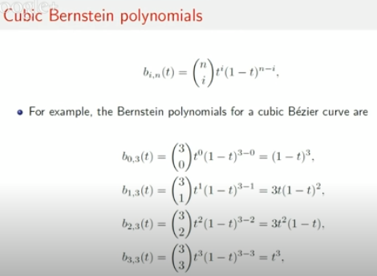
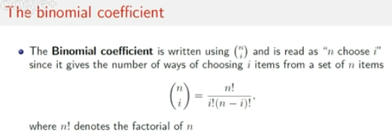

Slide 40
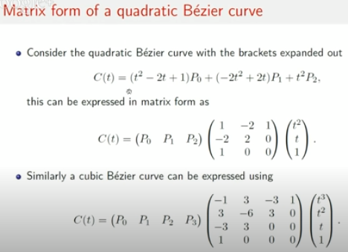

Slide 41
Properties of Bezier Curves
They generally follow the shape of the control polygon, which consists of the segments joining the control points.
They always pass through the first and last control points.
They are contained in the convex hull of their defining control points.
The degree of the polynomial defining the curve segment is one less that the number of defining polygon point. Therefore, for 4 control points, the degree of the polynomial is 3, i.e. cubic polynomial.
A Bezier curve generally follows the shape of the defining polygon.
The direction of the tangent vector at the end points is same as that of the vector determined by first and last segments.
The convex hull property for a Bezier curve ensures that the polynomial smoothly follows the control points.
No straight line intersects a Bezier curve more times than it intersects its control polygon.
They are invariant under an affine transformation.
Bezier curves exhibit global control means moving a control point alters the shape of the whole curve.
A given Bezier curve can be subdivided at a point t=t0 into two Bezier segments which join together at the point corresponding to the parameter value t=t0.

Slide 42
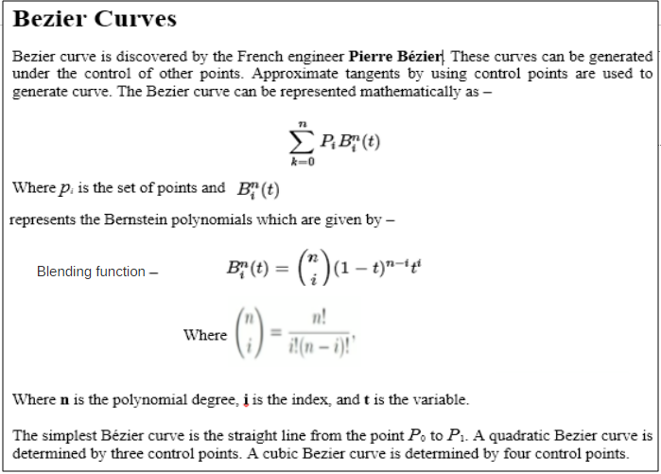
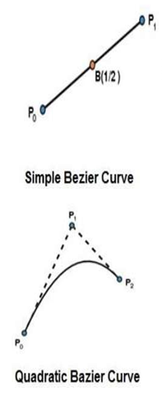
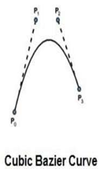

Slide 43
B-Spline Curves
The Bezier-curve produced by the Bernstein basis function has limited flexibility.
First, the number of specified polygon vertices fixes the order of the resulting polynomial which defines the curve.
The second limiting characteristic is that the value of the blending function is nonzero for all parameter values over the entire curve.
The B-spline basis contains the Bernstein basis as the special case. The B-spline basis is non-global. A B-spline curve is defined as a linear combination of control points Pi and B-spline basis function Ni, k (t) given by,

Slide 44
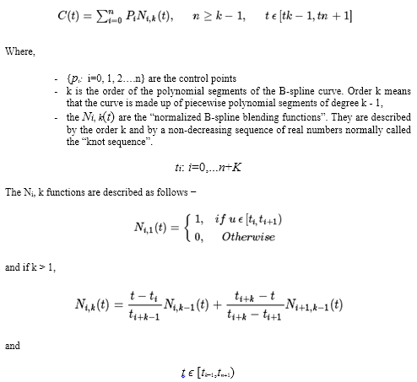
B-Spline Curves

Slide 45
Properties of B-spline Curve
The sum of the B-spline basis functions for any parameter value is 1.
Each basis function is positive or zero for all parameter values.
Each basis function has precisely one maximum value, except for k=1.
The maximum order of the curve is equal to the number of vertices of defining polygon.
The degree of B-spline polynomial is independent on the number of vertices of defining polygon.
B-spline allows the local control over the curve surface because each vertex affects the shape of a curve only over a range of parameter values where its associated basis function is nonzero.
The curve exhibits the variation diminishing property.
The curve generally follows the shape of defining polygon.
Any affine transformation can be applied to the curve by applying it to the vertices of defining polygon.
The curve line within the convex hull of its defining polygon.

